Slide 1
INSTRUCTIONAL EVALUATION SYSTEM
Evaluation Procedures and Criteria
Required Annual Training
2022-2023

Slide 2


Slide 3
FLORIDA STATUTE
1012.34
Personnel Evaluation Procedures and Criteria

Slide 4
EVALUATION SYSTEM
REQUIREMENTS/ PROCEDURES
FS 1012.34
The evaluation system must:
Be designed to support effective instruction and student learning growth, and the results must be used to develop district and school level improvement plans.

Slide 5
EVALUATION SYSTEM
REQUIREMENTS/ PROCEDURES
FS 1012.34
The evaluation system must:
Provide appropriate instruments, procedures, timely feedback, and criteria for continuous quality improvement of professional skills and must be used when identifying professional development.

Slide 6
EVALUATION SYSTEM
REQUIREMENTS/ PROCEDURES
FS 1012.34
The evaluation system must:
Be based upon the performance of students assigned to the classroom of instructional personnel.

Slide 7
EVALUATION DEFINITION
An evaluation is the summative compilation of evidence gathered over time from multiple observations, to include formal and informal observations. Evidence is also gathered via artifacts, documents and the Deliberate Practice Plan.
An evaluation is NOT a one-time observation and conference.

Slide 8
EVALUATION COMPONENTS
Instructional Practice
(65% of the evaluation score)
Student Performance
(35% of the evaluation score)

Slide 9
INSTRUCTIONAL PRACTICE
Comprises 65% of the evaluation score and is based upon the Marzano Framework / Model

Slide 10
MARZANO FRAMEWORK
Is the research-based model developed by Dr. Robert Marzano.
The “Focused Teacher Evaluation Model” defines 23 elements of teacher practice which are organized into four (4) “domains.”
Each element has a description, examples of teacher and student evidence, and a rubric that differentiates the degree of quality of the teacher’s expertise and use of the element.

Slide 11
MARZANO FRAMEWORK
The “Focused Non-Classroom Instructional Support Personnel (NCIP) Evaluation Model”, defines 11 elements of support practice, in addition to six (6) optional elements which are organized into four (4) “domains.”
Each element has a description, examples of support personnel and student evidence, and a rubric that differentiates the degree of quality of the support personnel’s expertise and use of the element.

Slide 12

One of the greatest barriers to school improvement is the lack of an agreed upon definition of what high quality instruction looks like. Elmore (2010)

Slide 13
A COMMON LANGUAGE OF INSTRUCTION
It is a well-articulated knowledge base that describes the complexity of teaching and describes key strategies revealed by the research to have a high probability of impacting student learning.
It also describes the instructional context for appropriate use of instructional strategies that have the highest probability for raising student achievement. The common language represents what a school or district defines as effective instruction based on contemporary research.

Slide 14
A COMMON LANGUAGE OF INSTRUCTION
A common language enables teachers to engage in professional conversations aimed at improving student achievement.
For administrators, a common language provides the means to offer focused formative and summative feedback. It supports administrators in making decisions regarding professional development, coaching and support for new or struggling teachers.

Slide 15
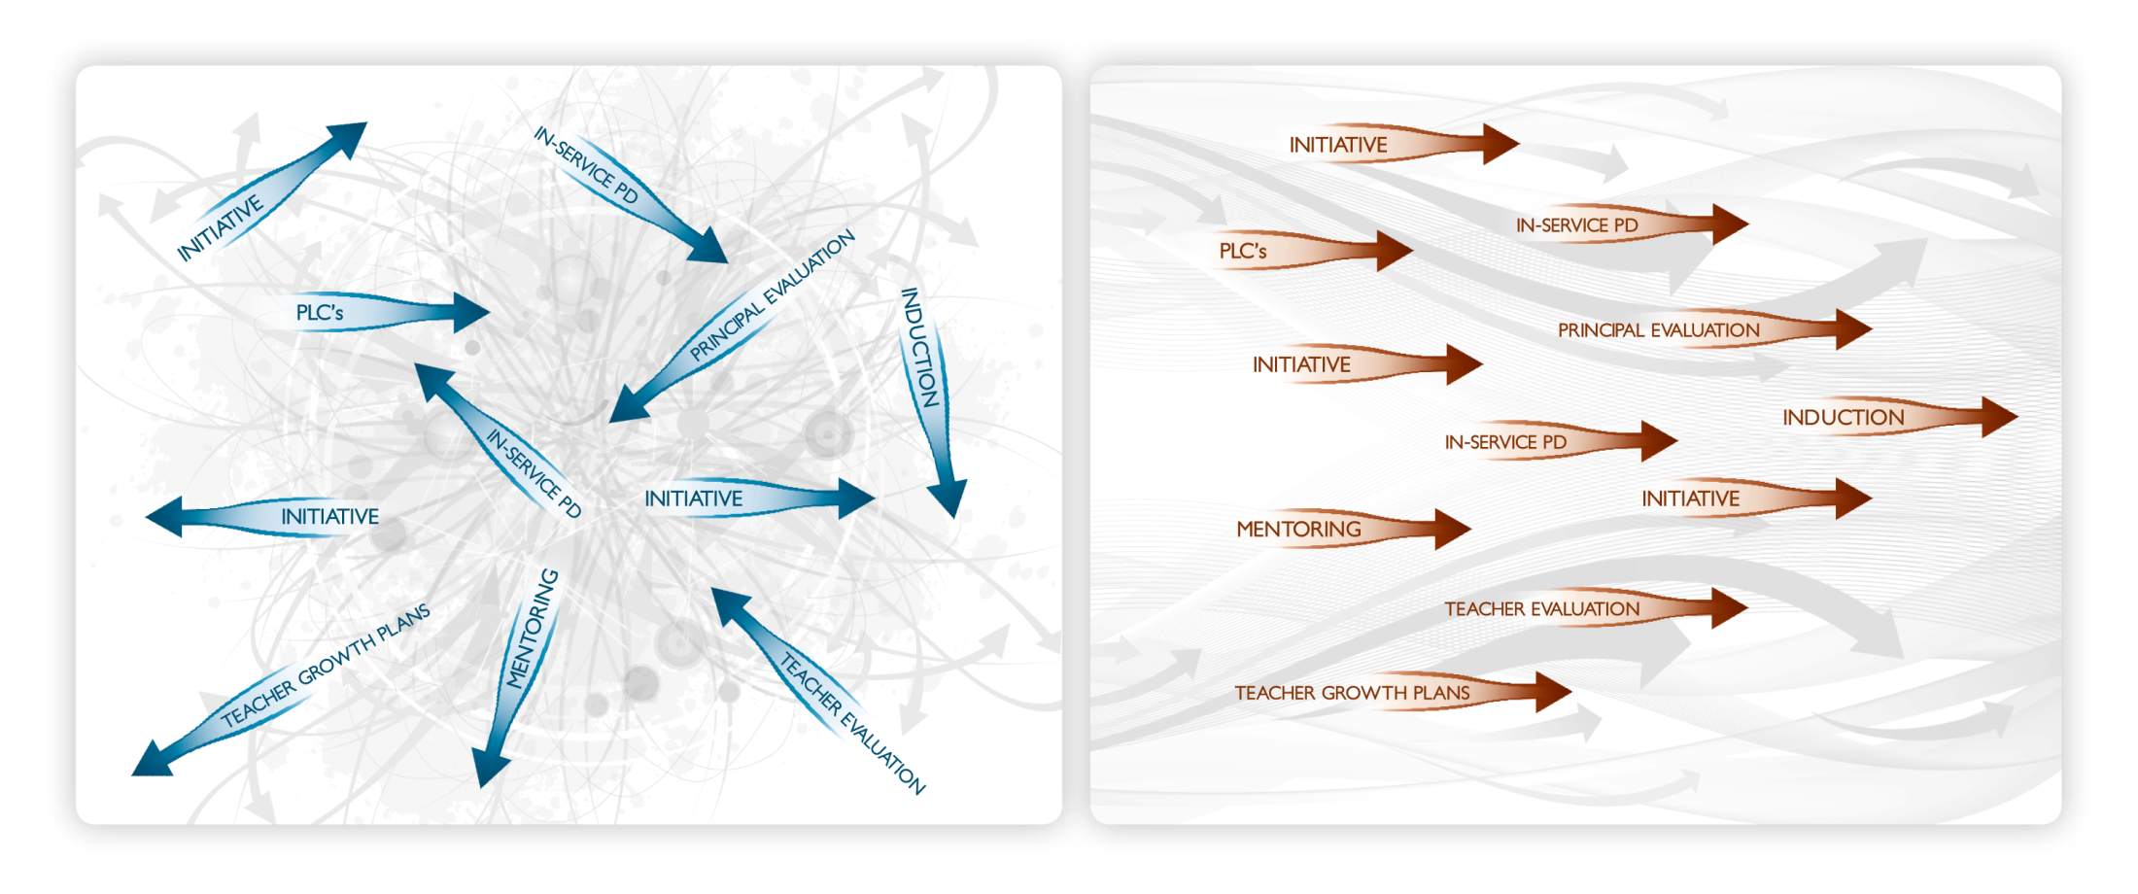
COMMON LANGUAGE OF INSTRUCTION ALIGNS SYSTEMS
MISALIGNED SYSTEM
ALIGNED SYSTEM
No Common Language or Model of Instruction
Common Language or Model of Instruction

Slide 16
MARZANO FRAMEWORK
The framework for classroom teachers is comprised of 4 domains.
Domain 1 – Standards-Based Planning comprises 20% of the instructional practice score.
Domain 2 – Standards-Based Instruction comprises 30% of the instructional practice score.

Slide 17
MARZANO FRAMEWORK Cont.
Domain 3 - Conditions for Learning comprises 30% of the instructional practice score.
Domain 4 – Professional Responsibilities comprises 20% of the instructional practice score.

Slide 18
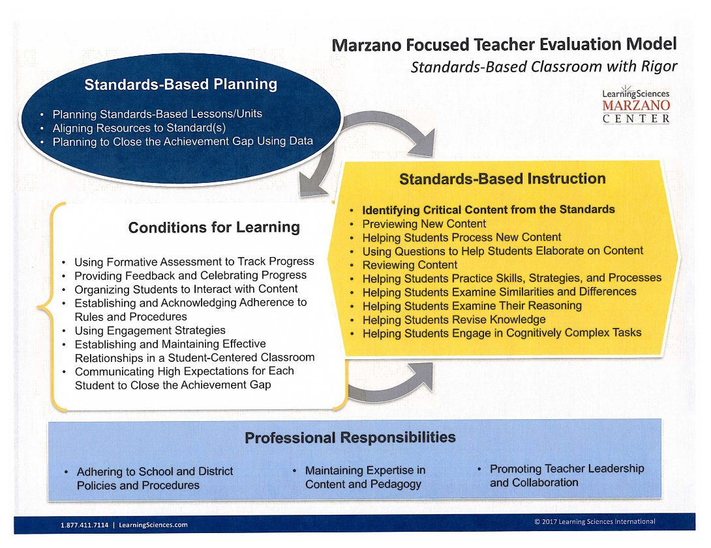

Slide 19
MARZANO FRAMEWORK Cont.
The framework for non-classroom instructional personnel (NCIPs) is comprised of 4 domains.
Domain 1 – Planning and Preparing to Provide Support comprises 20% of the instructional practice score.
Domain 2 – Supporting Student Achievement comprises 30% of the instructional practice score.

Slide 20
MARZANO FRAMEWORK Cont.
Domain 3 - Continuous Improvement of Professional Practice comprises 30% of the instructional practice score.
Domain 4 – Professional Responsibilities comprises 20% of the instructional practice score.

Slide 21
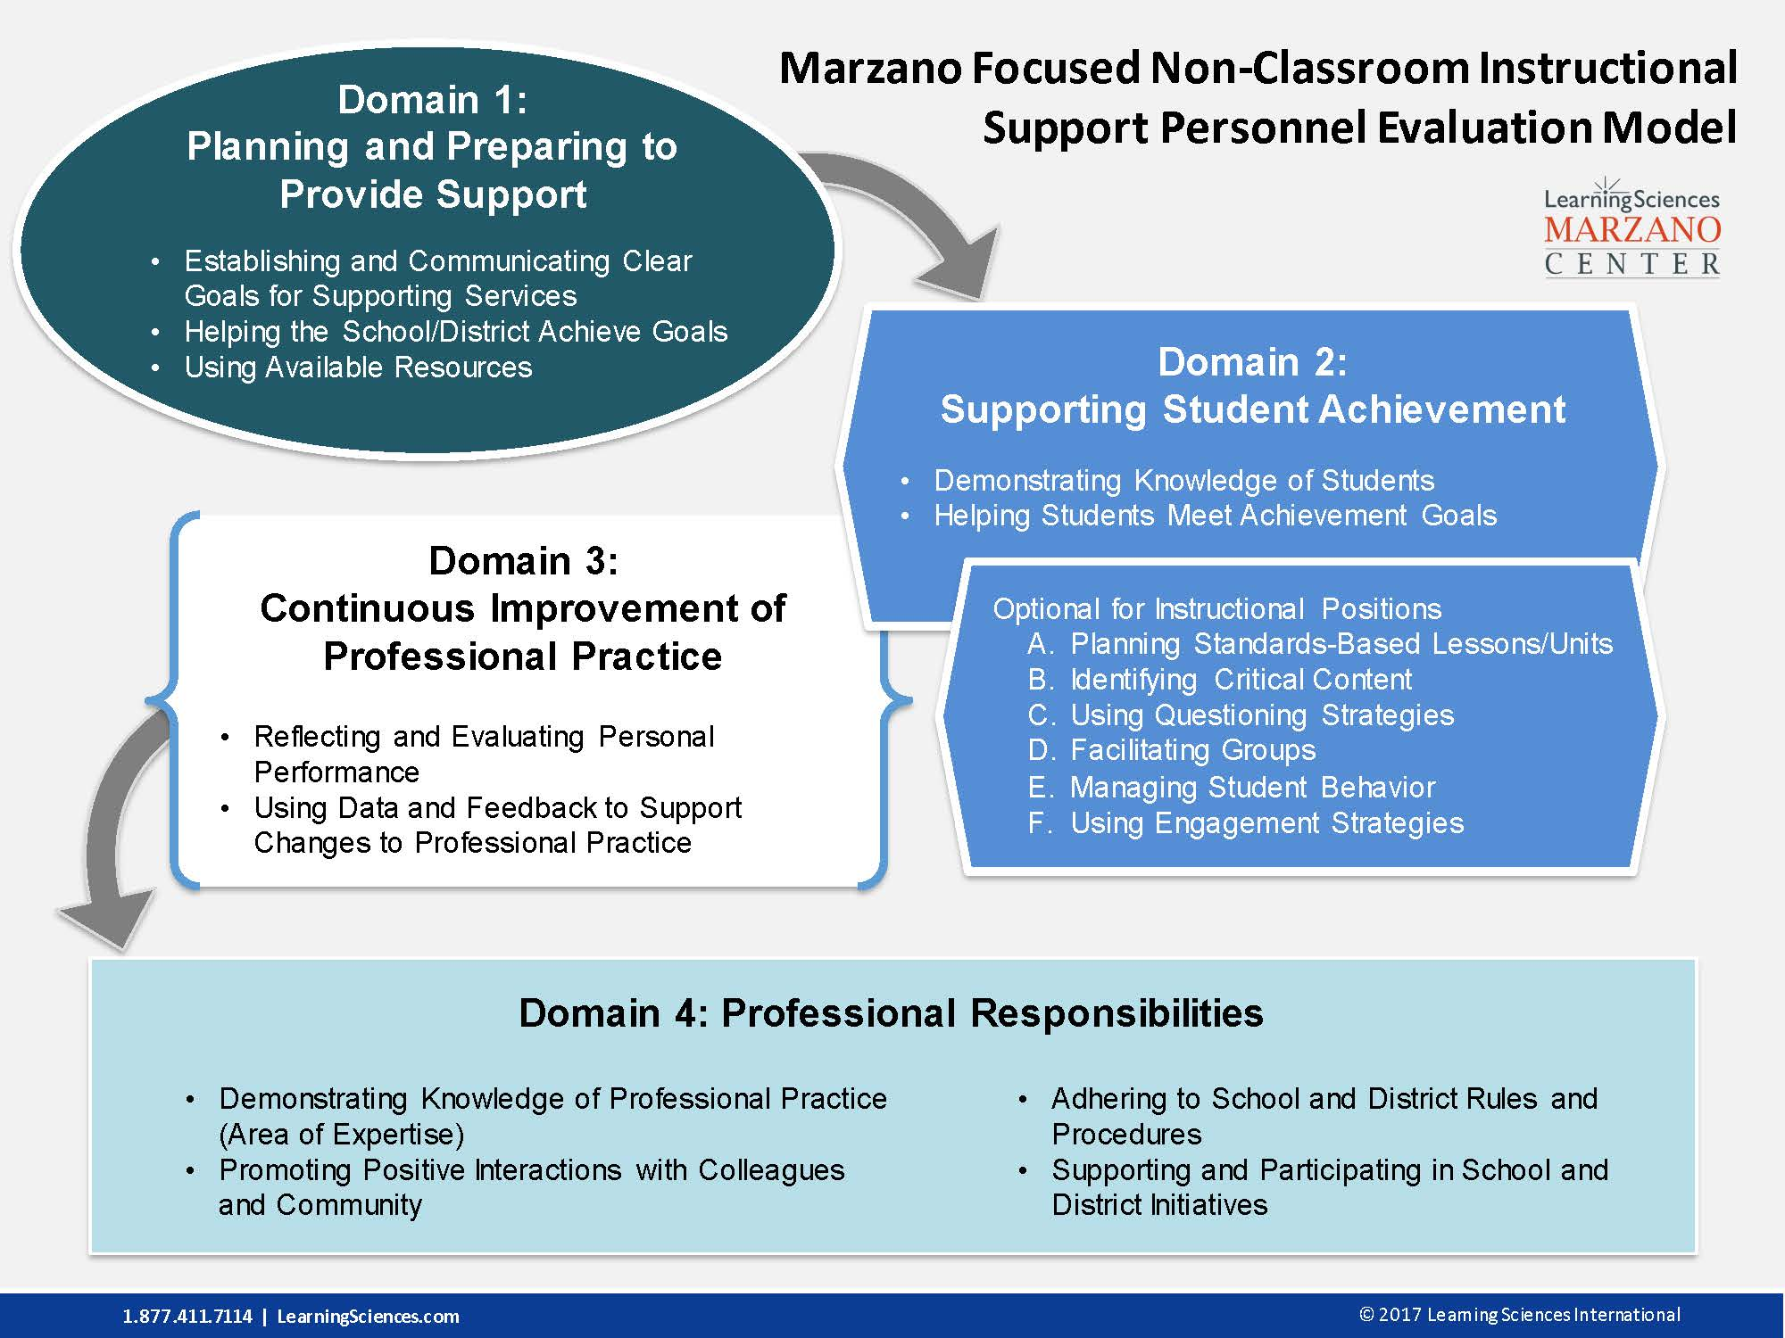

Slide 22
iObservation
A technology platform and system used for recording observation data by administrators, giving feedback, providing collaboration, documenting supportive evidence, and accessing professional development resources.
Under the “Resource Tab” teachers and NCIPs can find many resources, print and video, to deepen their understanding of the domains and elements/strategies.

Slide 23


Slide 24
Who Conducts the Observations and Evaluations?
The individual responsible for supervising the employee must evaluate the employee’s performance, per Statute.
This would be either the principal or assistant principal of the school.

Slide 25
NUMBER OF EVALUATION CYCLES
Two (2) for classroom teachers and non-classroom instructional personnel (NCIPs) in their first year of employment in the district or returning to employment in the district after a break in service of more than one (1) year; the first cycle is the Mid-point Evaluation and the second cycle is the Final Evaluation.
One (1) for all other instructional personnel, excluding instructional personnel on a Professional Development Plan (PDP).

Slide 26
NUMBER OF EVALUATION CYCLES Cont.
All other instructional personnel includes classroom teachers not new to the district; or those who are returning from a leave of absence of one year or less; or those who were reduced in force and were placed within the following school year; or those who were terminated and were reemployed at the beginning of the following school year and all non-classroom instructional personnel (NCIPs).

Slide 27
NUMBER AND DESCRIPTION OF OBSERVATIONS
Per evaluation cycle, for classroom teachers and NCIPs in their first year of employment in the district or returning to employment in the district after a break in service of one year or more:
Two (2) Informal Observations, (10 minutes or more) – Announced or Unannounced.
One (1) Formal Observation (30 minutes or more) – Announced or Unannounced.

Slide 28
NUMBER AND DESCRIPTION OF OBSERVATIONS
For classroom teachers and NCIPs who are not new to the district:
One (1) Informal Observation (10 minutes or more) – Announced or Unannounced
One (1) Formal Observation (30 minutes or more) – Announced or Unannounced.

Slide 29
OBSERVATION AND EVALUATION DEADLINES
Midpoint Observations for classroom teachers new to the district – Completed by December 15^{th.}
Final Observations for classroom teachers new to the district and all other instructional personnel – Completed by March 15^{th.}

Slide 30
STUDENT PERFORMANCE
Comprises 35%
of the evaluation score

Slide 31
STUDENT PERFORMANCE Cont.
FS 1012.34 stipulates the following regarding the performance evaluations of instructional and administrative personnel:
It must be based upon the performance of students assigned to their classrooms or schools;
At least 1/3 (33.3%) must be based upon indicators of student performance, as determined by the District; and

Slide 32
STUDENT PERFORMANCE Cont.
It must include growth or achievement data of the teacher’s students over the course of three (3) years, and for school administrators, the students attending the school over the course of three (3) years.
If less than three (3) years of data is available, the years for which data are available must be used.

Slide 33
STUDENT PERFORMANCE Cont.
NCSB’s student performance indicators include teacher-made tests and district selected tests, which include state assessments.
District selected tests include, but are not limited to the FAST, ACCESS, ULSA, AP Exams, TABE and Industry Certifications, etc.
A complete listing will be available in the Instructional Evaluation System, which will be posted on the website.

Slide 34
REQUIRED PERFORMANCE LEVELS
As per Statute, the evaluation performance levels are:
Highly Effective
Effective
Needs Improvement / Developing (“Developing” will be used for instructional personnel in their first 3 years of employment, as applicable, in lieu of “Needs Improvement.”
Unsatisfactory

Slide 35
PROCEDURAL OVERVIEW
Per Statute, the person responsible for supervising the employee must evaluate the employee.
The administrator conducts the required number of observations (2 Informal Observations, and 1 Formal Observation for teachers new to the district and 1 Informal Observation and 1 Formal Observation for teachers not new to the district and all NCIPs).
Prior to each announced formal observation, pre-observation information may be requested, utilizing the Planning Conference / Pre-Observation Form.

Slide 36
PROCEDURAL OVERVIEW Cont.
The administrator conducts a post-observation conference with the employee within 10 days of completion of the final formal observation.
During that meeting, the observation results and ratings, for all 4 domains, are discussed and the Annual Evaluation Report is completed.
The signed, original Annual Evaluation Report is sent to Personnel. This normally takes place at the end of the school year. Annual Evaluation reports completed for mid-point evaluations are sent in when completed.

Slide 37
PROCEDURAL OVERVIEW Cont.
Concerns or unsatisfactory performance that may result in a Developing / Needs Improvement or Unsatisfactory rating of the Instructional Performance Score must be documented on the Notification of Less Than Effective Performance Form, prior to the evaluation taking place.
This form must be given to the employee in sufficient time, prior to the formal evaluation, IF POSSIBLE, so as to provide the employee with time for improvement.

Slide 38
PROCEDURAL OVERVIEW Cont.
The aforementioned requirement does not pertain to student performance data, teacher misconduct, or lack of adherence to safety concerns.
See Appendix 6 – Notification of Less than Effective Performance For Instructional Personnel Form.

Slide 39
PROCEDURAL OVERVIEW Cont.
When current year student performance data becomes available, the Final Summative Evaluation Form, which includes both the instructional practice score and the student performance score, is completed and discussed with the employee.
The signed, original Final Summative Evaluation Form is sent to Personnel.
The signature of the employee only serves to acknowledge that the form has been read and that it has been discussed with the employee. It does not necessarily indicate agreement with its content.

Slide 40
PROCEDURAL OVERVIEW Cont.
Employees who receive a notice of “Unsatisfactory Performance” will be placed on a Professional Development Plan (PDP).
Upon completion of an evaluation, the employee has the right to submit a written response to the evaluation, and the response will be placed in his/her permanent record file in Personnel.

Slide 41
PROCEDURAL OVERVIEW Cont.
Employees who are placed on a PDP must be provided assistance to help correct the noted performance deficiencies, thus helping to realize…
The Goal of Teacher Evaluation
“An expectation that ALL teachers can increase their expertise from year to year, which produces gains in student achievement from year to year with a powerful cumulative effect.”

Slide 42

QUESTIONS

Slide 43


